Slide 1
FAFNIR: Accelerating Sparse Gathering by Using Efficient Near-Memory Intelligent Reduction
Junseo Lee
Electrical and Computer Engineering
Seoul National University

Slide 2
Table of Contents
What is Recommendation System?
Example of Recommendation System: DLRM
Bottleneck of Recommendation System: Embedding layer
Brief Description of State-of-the-Art Solutions of Embedding
Compositional embedding
Tensor Casting
FAFNIR
Challenges of prior solutions
Comparison with prior solutions
Contributions
Evaluation
Question
Conclusion

Slide 3
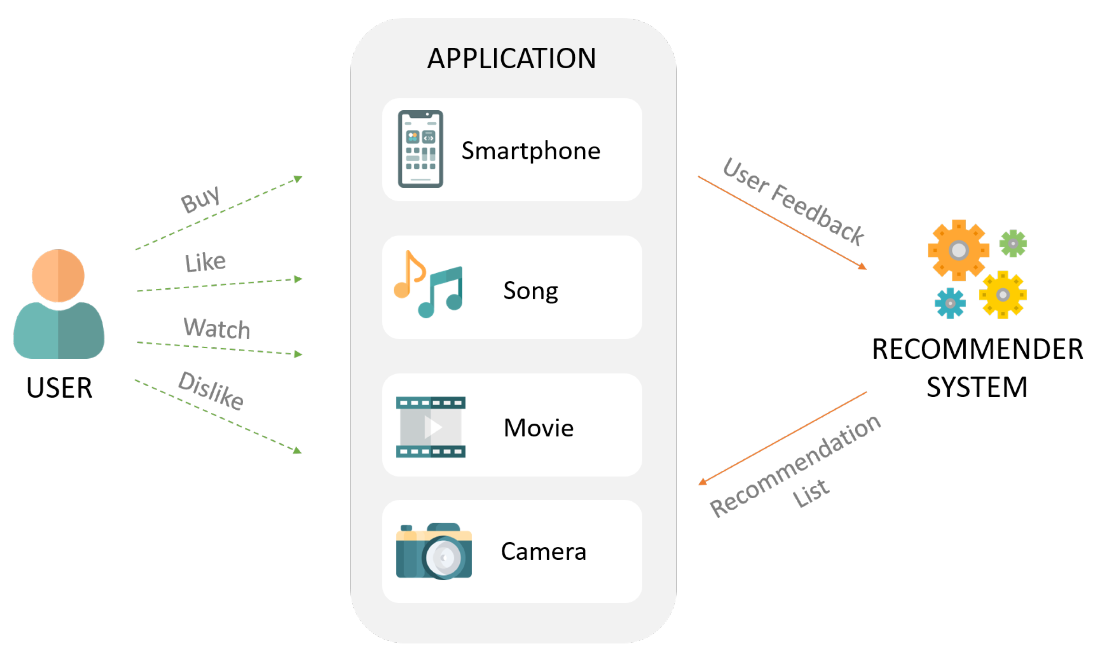
What is Recommendation System?
Goal: Predict the "rating" or "preference" a user would give to an item
Example: YouTube, Netflix recommendation system, Facebook DLRM

Slide 4
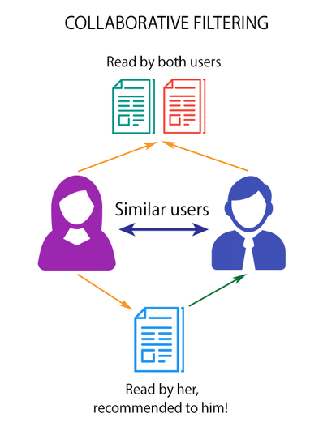
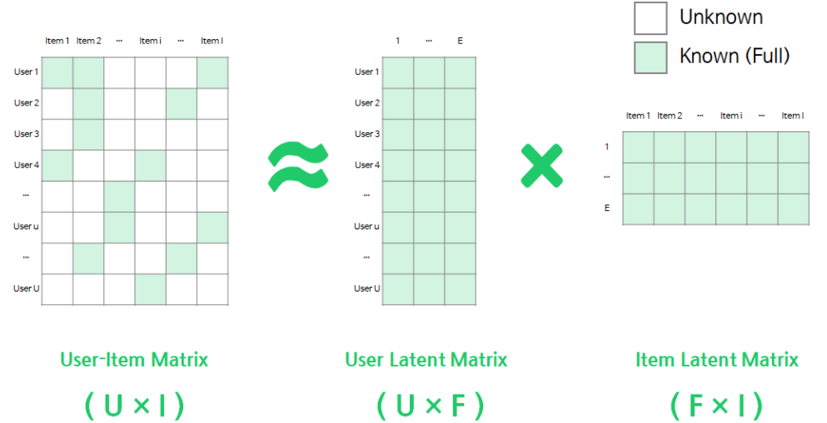
What is Recommendation System?
Collaborative filtering
If someone similar to you likes this item, you are likely to prefer the item either.
Matrix factorization
“Factorize” a user-item matrix into user & item embedding vectors (=latent factors)
Good for “sparse” data (lack of data)
One of the methods of matrix factorization is SVD (singular value decomposition), but not good for sparse user-item matrix

Slide 5
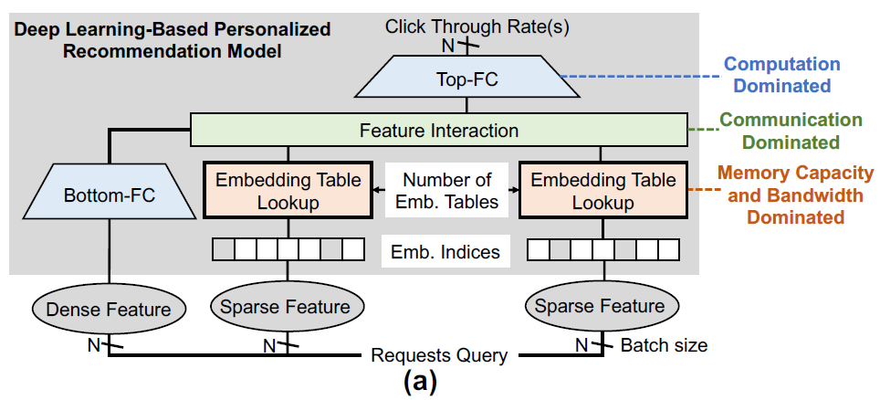
Example of Recommendation System: DLRM
DLRM = Deep Learning Recommendation System (Facebook)
Sparse feature (categorical data) → Embedding layer
e.g., watch history, location (country)
Dense feature (continuous data) → MLP (Multilayer Perceptron)
e.g., watch time, time since last watch

Slide 6
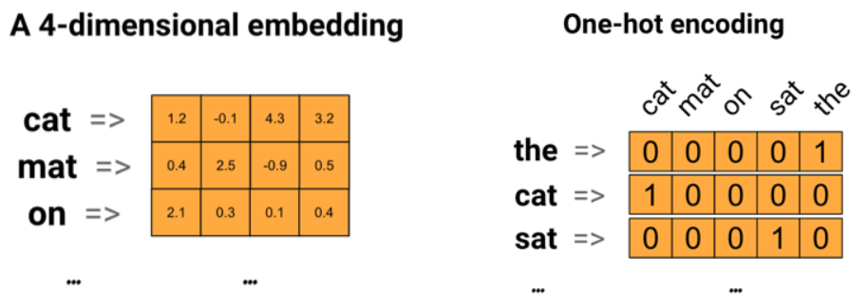
Embedding Table
One-hot encoding
One categorical data can be represented as one-hot vector
This is not a semantic feature
To use meaningful data for ML, one-hot vector should be converted to the feature which has its own characteristics
Embedding vector (latent factor)
Semantic feature representing categorical data mapped to latent factor space
The distance of two vectors in the latent factor space means the similarity of two features
e.g., King – Queen
= Man – Woman

Slide 7
Embedding Table
Problems of embedding layer: Memory intensive operation
Require high memory capacity
Tens of MBs to several GBs
The number of embedding tables varies from 4 to 40
Irregular memory accesses
Low cache hit rate
On an Intel Broadwell server present in production data centers, this results in a high LLC cache miss rate.
LLC cache miss rate of 8 MPKI (in production-scale recommendation model) compared to 0.5 MPKI, 0.2 MPKI, and 0.06 MPKI in an RNN, FC, and CNN layers
It result in TLB miss handling cost and prefetching pollution
Low memory bandwidth utilization
Prior solutions for embedding layer problem do not fully utilize the memory bandwidth

Slide 8
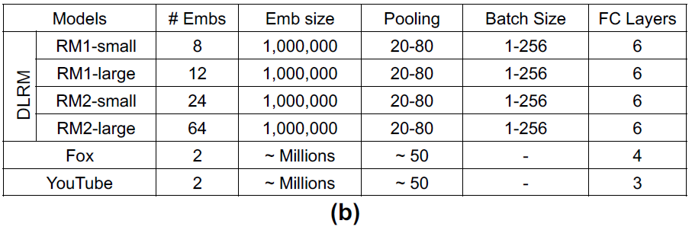
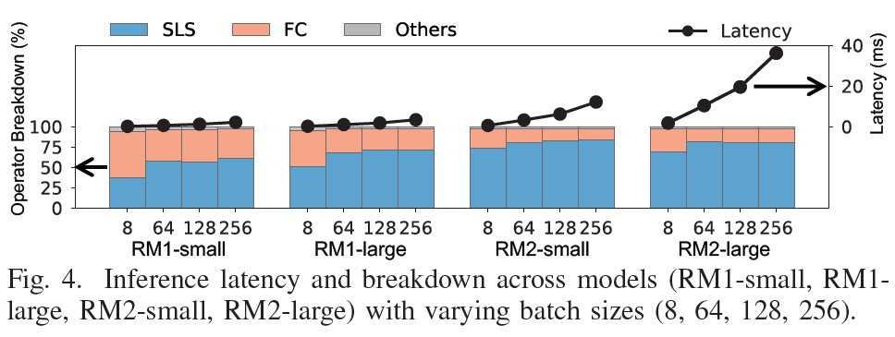
Bottleneck of Recommendation System: Embedding layer
SparseLengthsSum(SLS) is embedding operator in Caffe2
RM1, 2 are two representative recommendation models in Facebook’s production datacenter
RM1 is a comparatively smaller model with few embedding tables; RM2 has tens of embedding tables
Reference: The Architectural Implications of Facebook's DNN-Based Personalized Recommendation (HPCA ’20)
Operator latency: SLS(embedding layer) > FC > Others

Slide 9
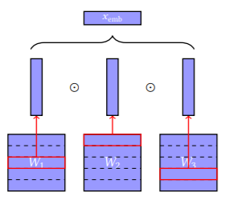
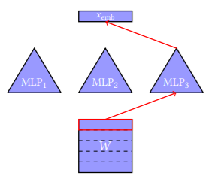
Solutions of Memory-Intensive Embedding
Compositional embedding
Reduce the size of embedding table
Operation-based: concatenation, addition, element-wise multiplication
Path-based: linear function, MLP
Partition
Quotient-Remainder complementary partitions
Generalized Quotient-Remainder complementary partitions
Chinese remainder partitions
Naïve partition

Slide 10
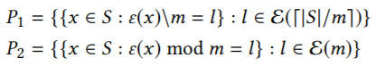
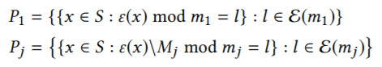
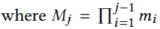
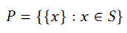
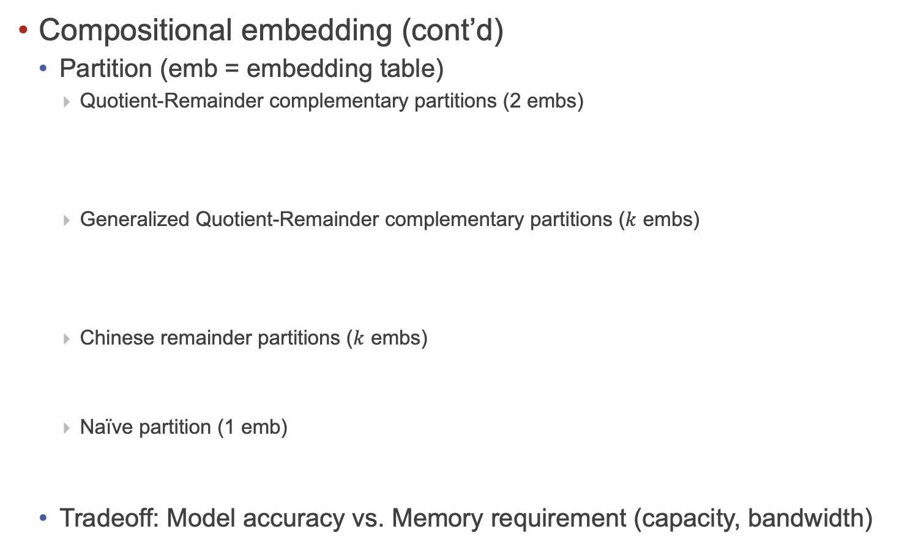
Solutions of Memory-Intensive Embedding
Compositional embedding (cont’d)
Partition (emb = embedding table)
Quotient-Remainder complementary partitions (2 embs)
Generalized Quotient-Remainder complementary partitions ($k$ embs)
Chinese remainder partitions ($k$ embs)
Naïve partition (1 emb)
Tradeoff: Model accuracy vs. Memory requirement (capacity, bandwidth)

Slide 11
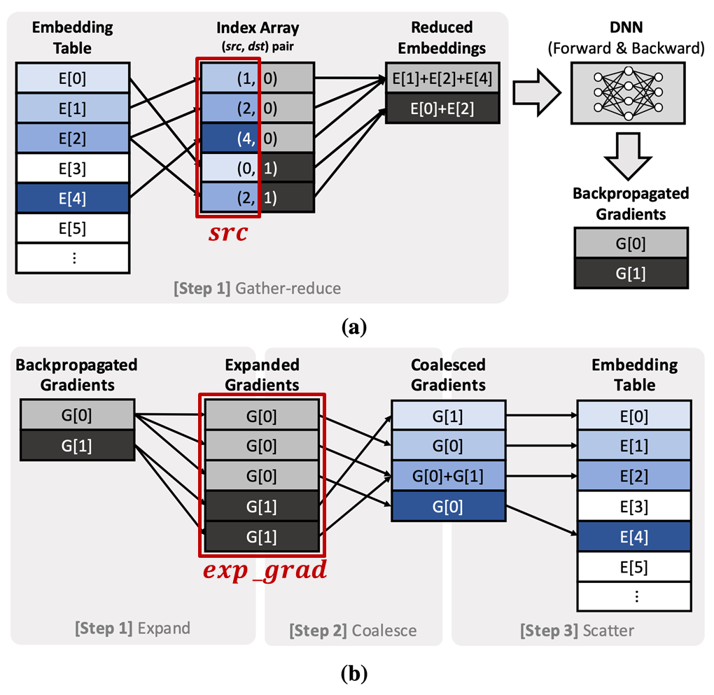
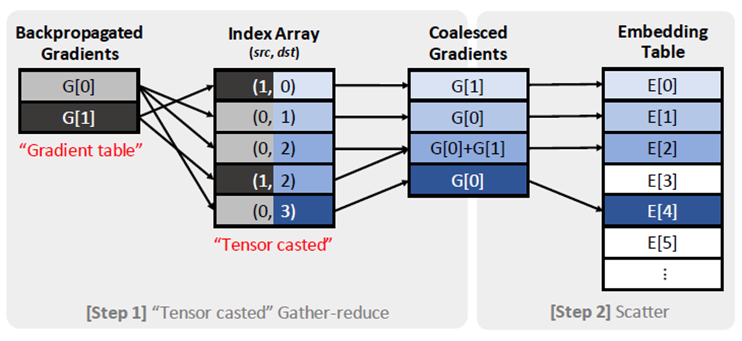
Solutions of Memory-Intensive Embedding (cont’d)
Tensor Casting (HPCA ’21)
Target: Backpropagation stage of embedding layer
Contribution
Gradient expand-coalesce operation is a bottleneck of backpropagation stage
Cast gradient expand-coalesce to tensor gather-reduce because it is just inverse process of gather-reduce operation

Slide 12
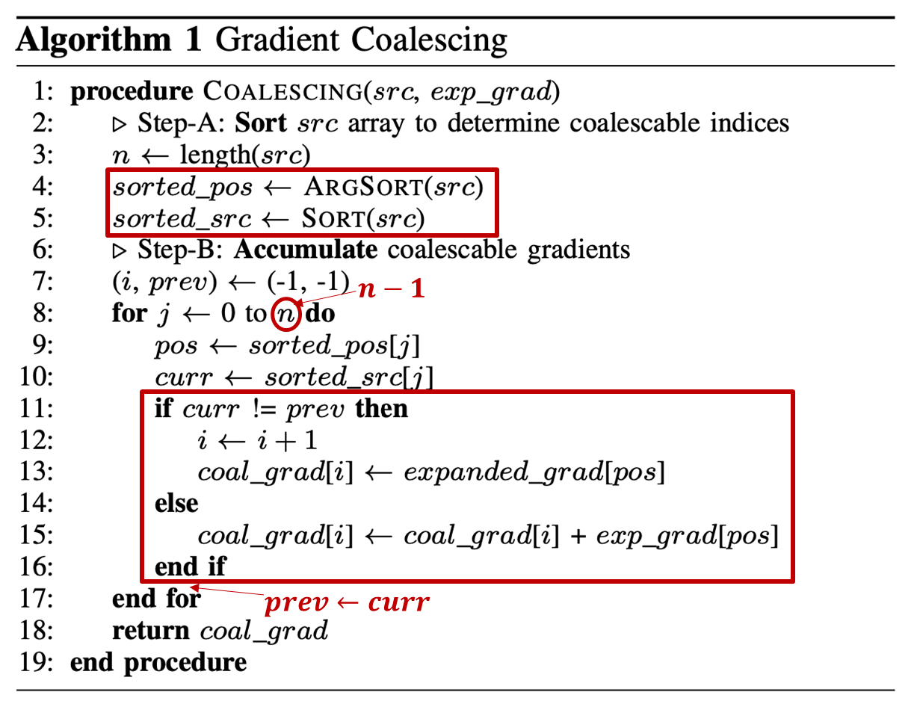
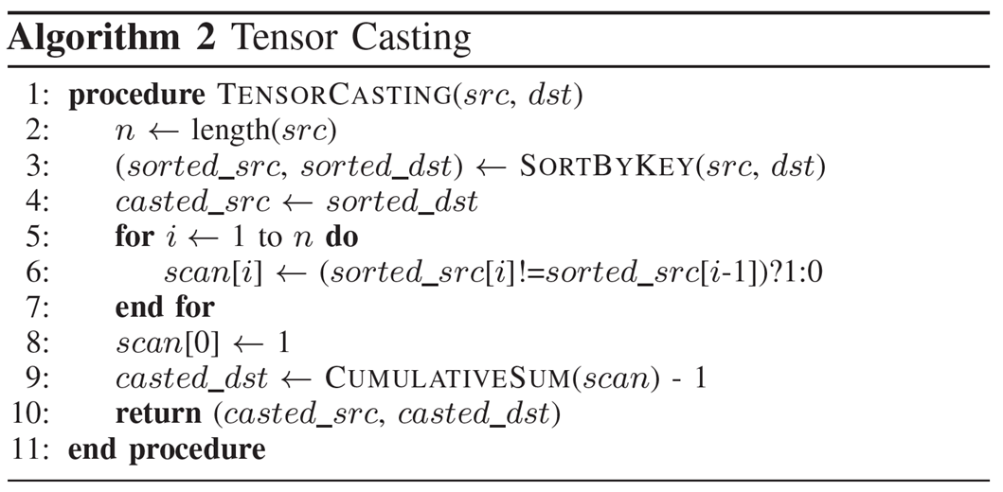
Solutions of Memory-Intensive Embedding (cont’d)
Tensor Casting (HPCA ’21) (cont’d)

Slide 13
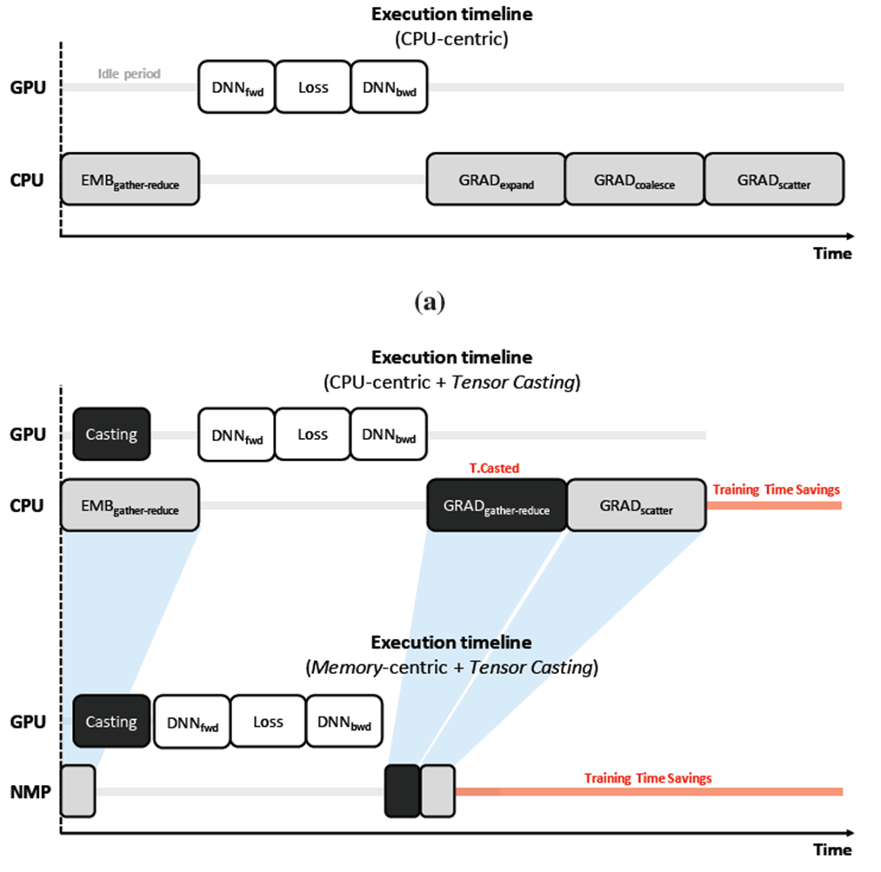
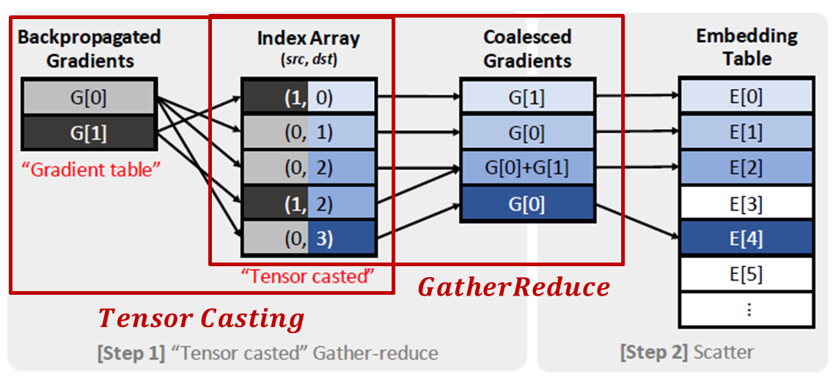
Solutions of Memory-Intensive Embedding (cont’d)
Tensor Casting (HPCA ’21) (cont’d)

Slide 14
FAFNIR
Challenges of prior solutions
Data movement
(# queries) x (# vectors in a query) x (vector size) elements must be transferred from memory systems to cores: Memory bandwidth problem
Goal: reduce the amount of data movement
Lack of utilization of row buffer locality
TensorDIMM
column-major order, which breaks the row-buffer locality in the DRAM system
splitting embedding vectors across more ranks causes poor utilization of row-buffers
Relying on spatial locality
RecNMP
If low spatial locality, parallel compute at NDP is low compared to that of in theory, DIMM-level parallelsim X
Connection overhead
# of connections (𝑐 x 𝑚) is not scalable for adding more ranks
Using cache to reduce memory access is not a good solution ☹
RecNMP: 128KB rank-level cache adds extra HW overhead but hit rate is ~50%

Slide 15
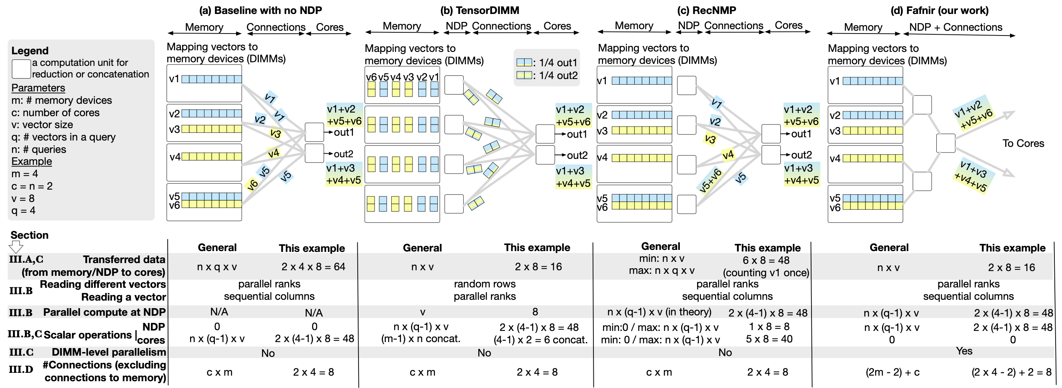
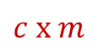
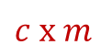

FAFNIR
Comparison with prior solutions
$$c x m$$
$$c x m$$
$$c x m$$

Slide 16
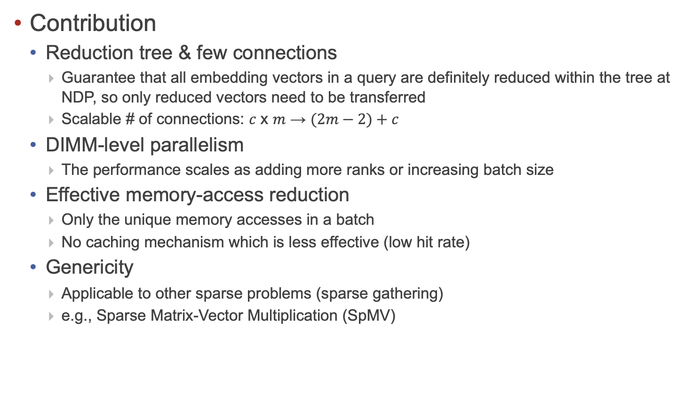
FAFNIR
Contribution
Reduction tree & few connections
Guarantee that all embedding vectors in a query are definitely reduced within the tree at NDP, so only reduced vectors need to be transferred
Scalable # of connections: 𝑐 x 𝑚 → $(2m−2)+c$
DIMM-level parallelism
The performance scales as adding more ranks or increasing batch size
Effective memory-access reduction
Only the unique memory accesses in a batch
No caching mechanism which is less effective (low hit rate)
Genericity
Applicable to other sparse problems (sparse gathering)
e.g., Sparse Matrix-Vector Multiplication (SpMV)

Slide 17
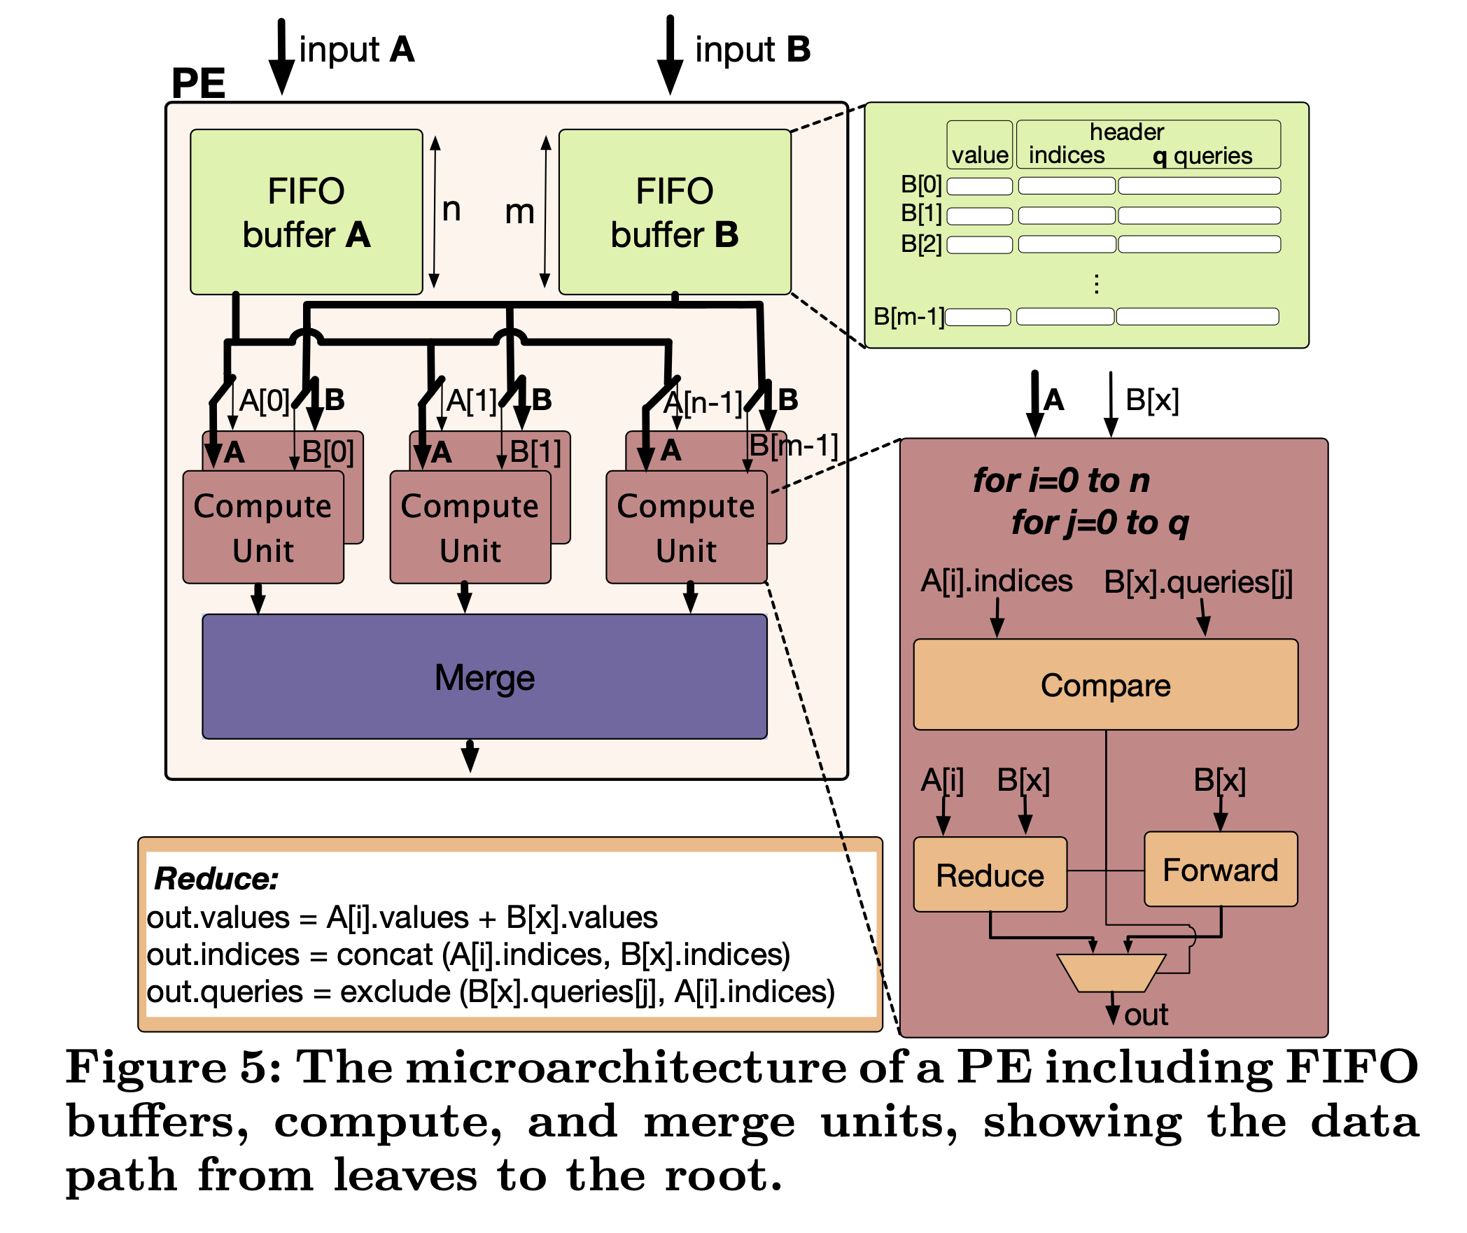
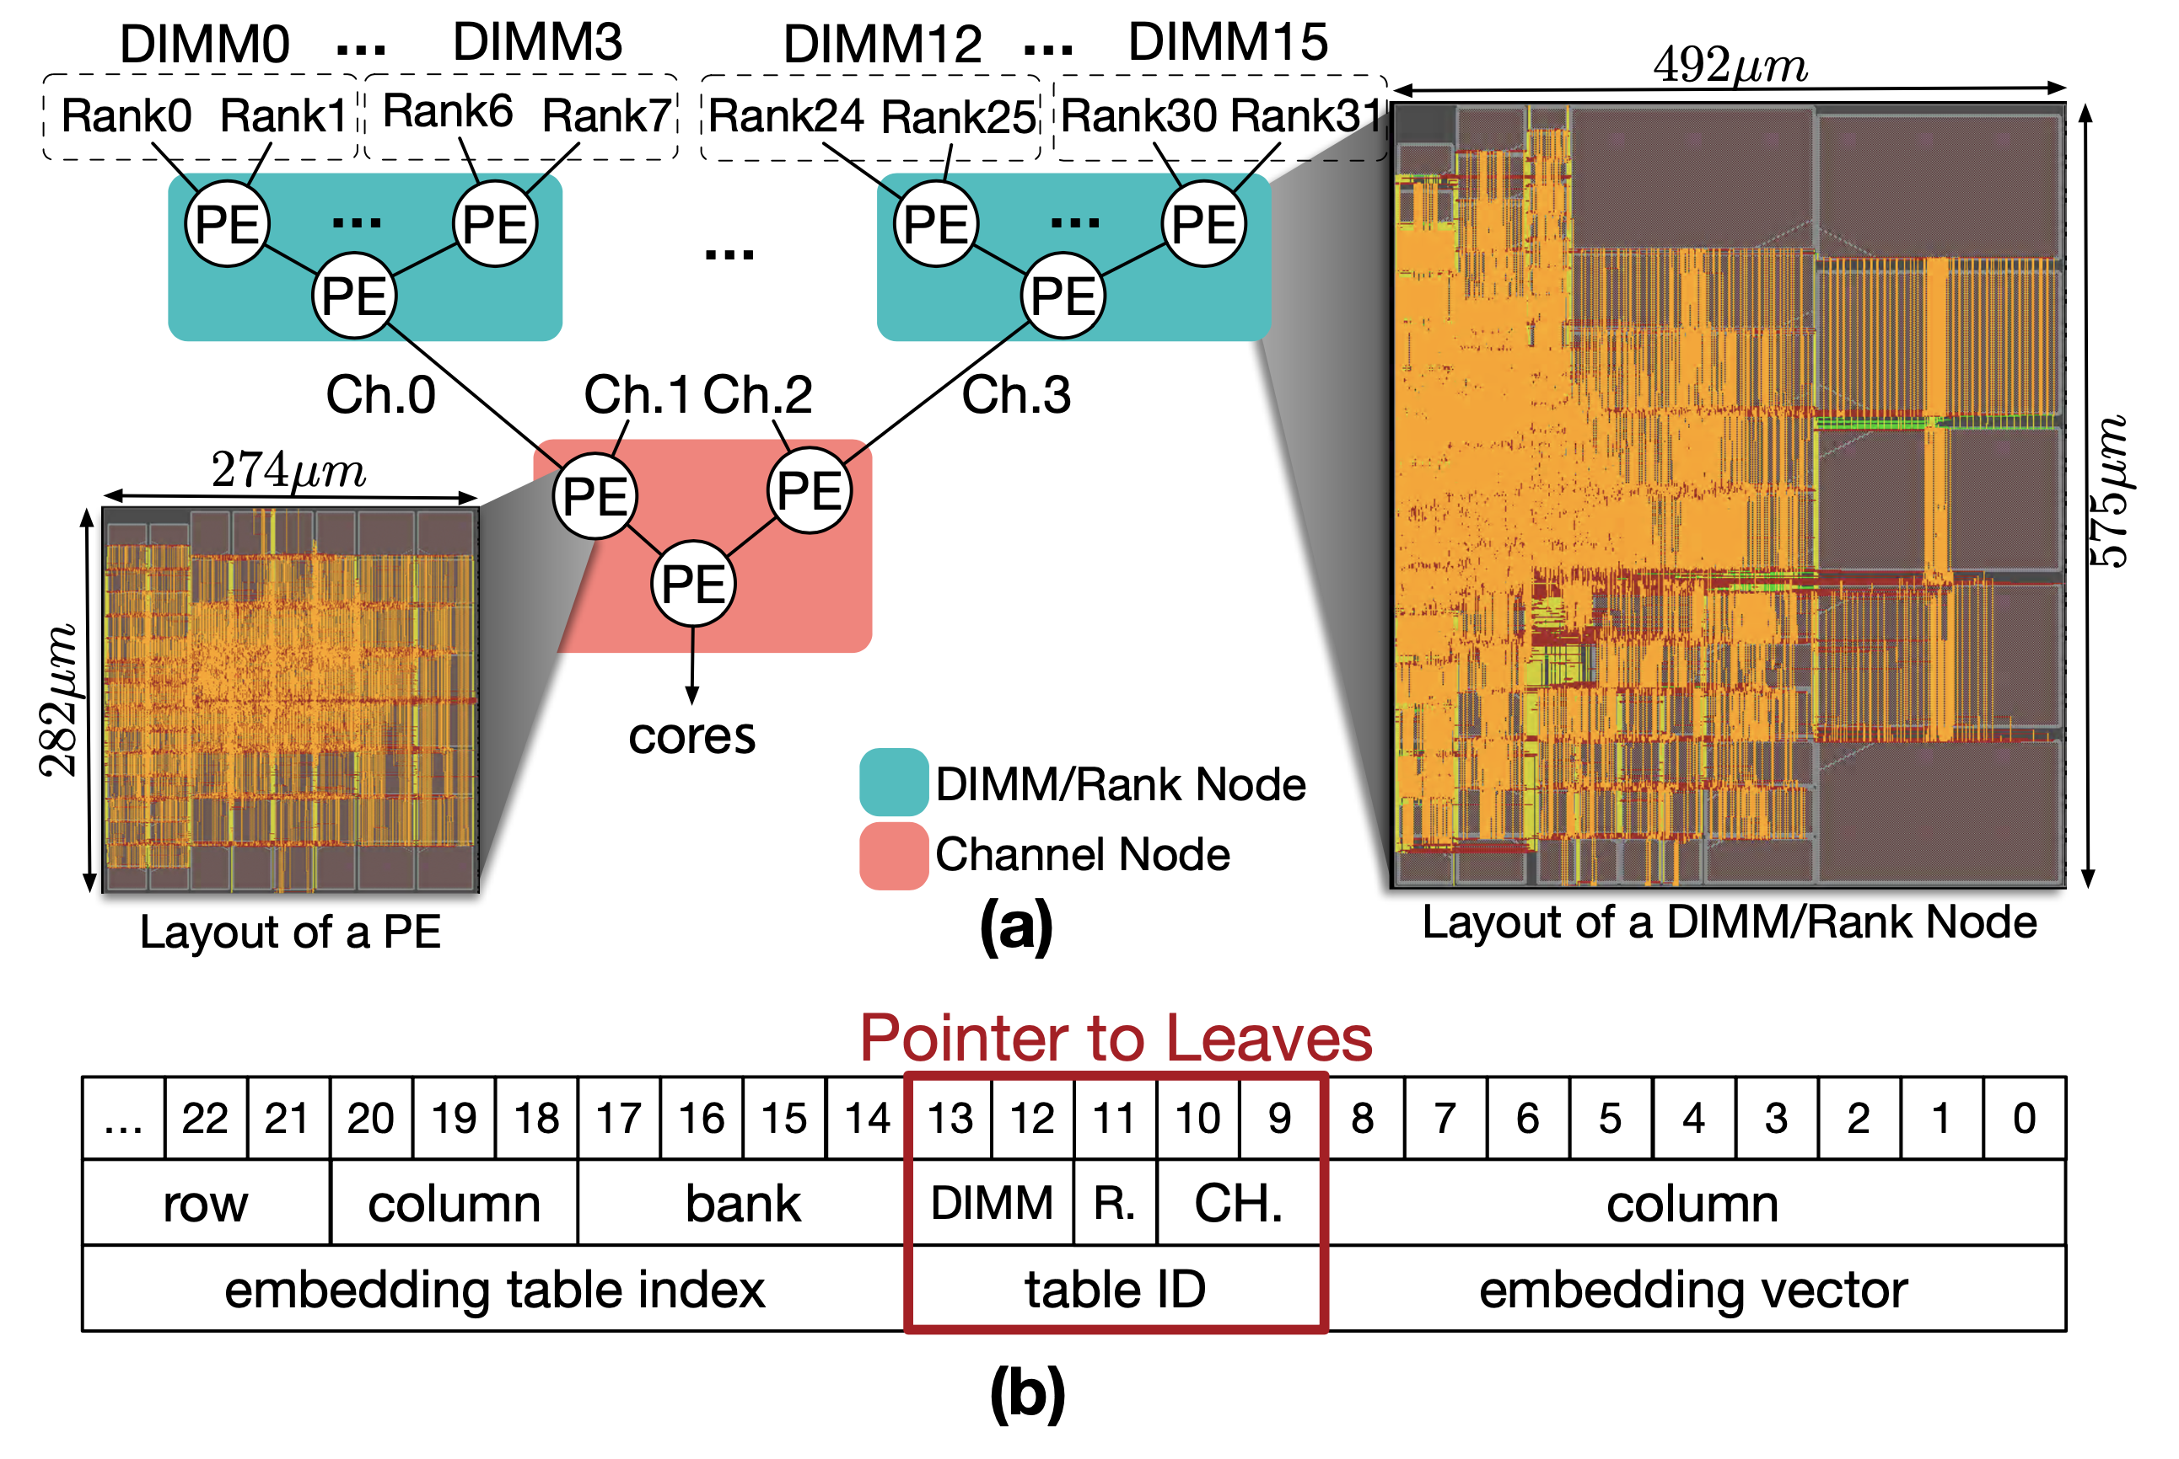
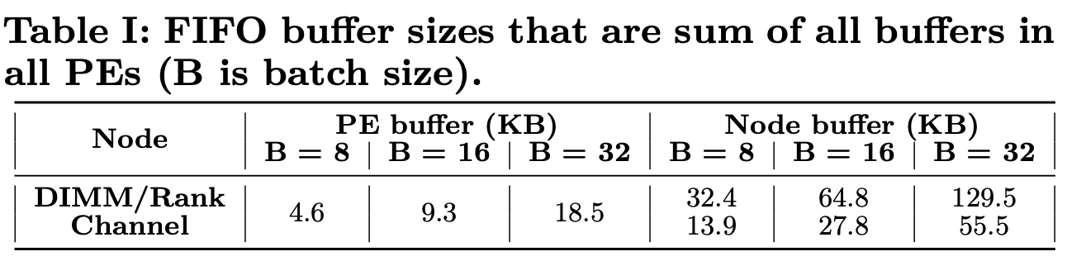
FAFNIR
Reduction Tree
2 channels, 8 DIMMs / channel, 2 ranks / DIMM
4 DIMM/rank nodes, 1 channel node
7 PEs per DIMM/rank node
Cache size(RecNMP): 128KB
Buffer size: 129.5KB for B=32 ?

Slide 18
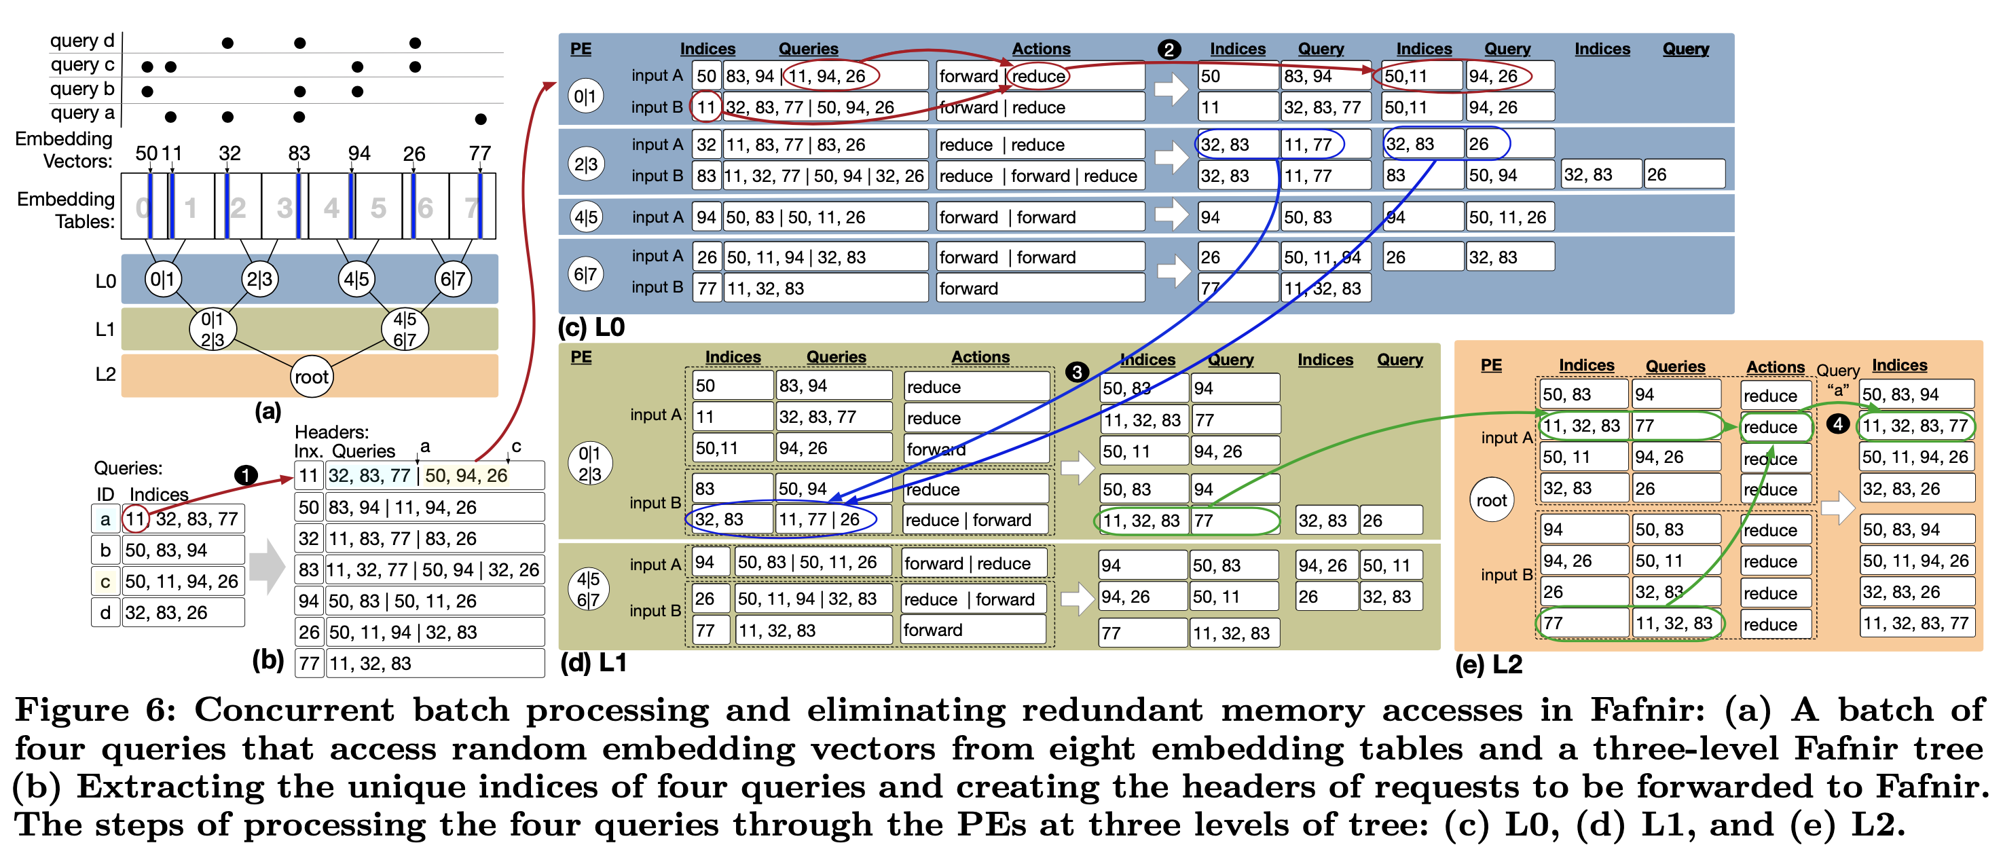
FAFNIR
Reduction Tree (cont’d)
Indices: concatenation of the index within table and a table number (assumption)
e.g., 50 = index 5 from table 0

Slide 19
FAFNIR
Reduction Tree (cont’d)
(b): "remaining indices" of queries containing "Inx" (unique set of indices)
e.g., Query a and c have index 11 → queries of headers = a(32, 83, 77) + c(50, 94, 26)
(c): reduce = if there is a query among B[x].queries which is same as A[i].indices, do reducing
out.indices = concat(A[i].indices, B[x].indices)
out.queries = exclude(B[x].queries, A[i].indices) (= B[x].queries - A[i].indices)
e.g., out.indices = concat(11, 50), out.queries = exclude([11, 94, 26], 11)

Slide 20
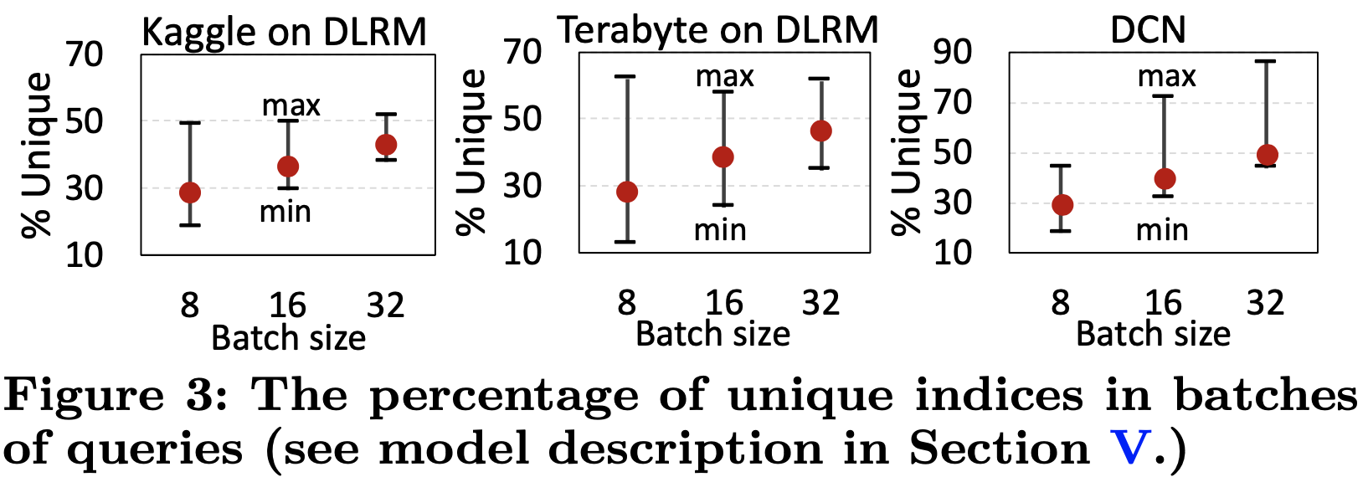
FAFNIR
Effective memory-access reduction
Only the unique memory accesses in a batch

Slide 21
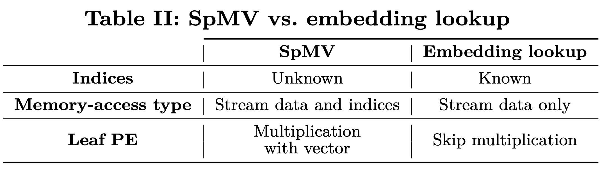
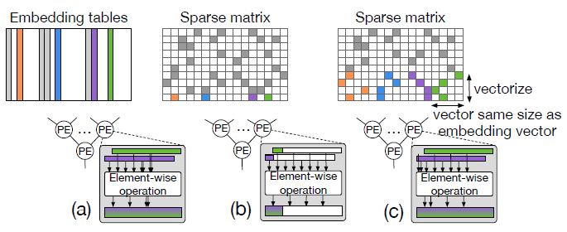
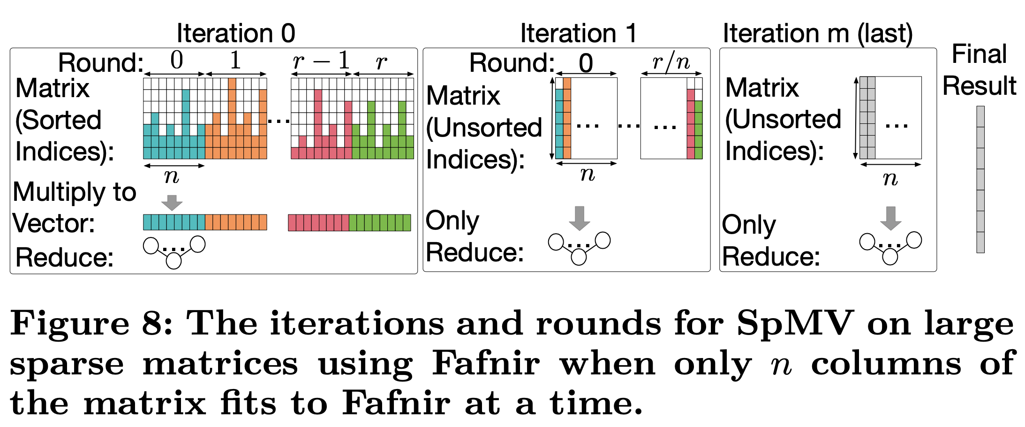
FAFNIR
Genericity
Applicable to other sparse problems (sparse gathering)
SpMV
Main difference: embedding - vectors → one vector, SpMV – vector → element
Vectorization: gathering non-zero elements in sparse matrix as continuous vectors

Slide 22
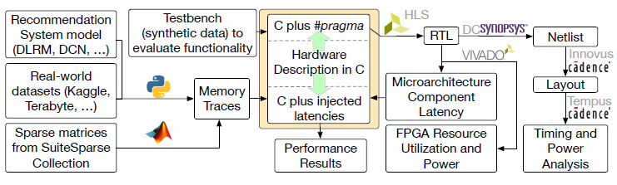
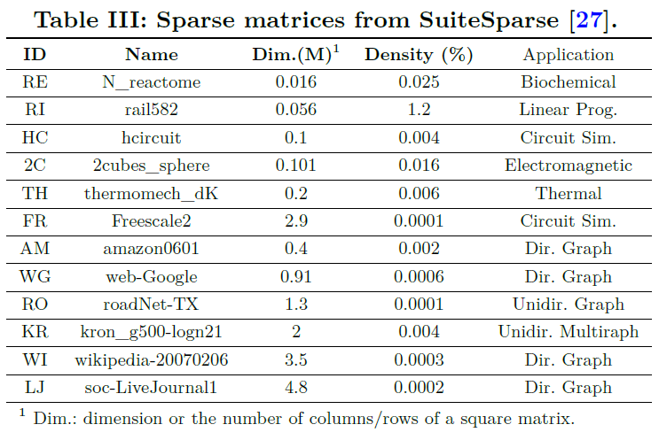
FAFNIR
Evaluation
Experimental setup
Sparse matrices
Six from the scientific domain
Six graphs

Slide 23
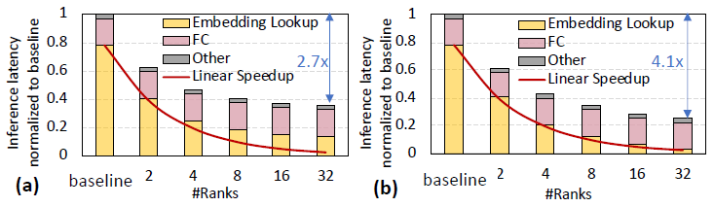
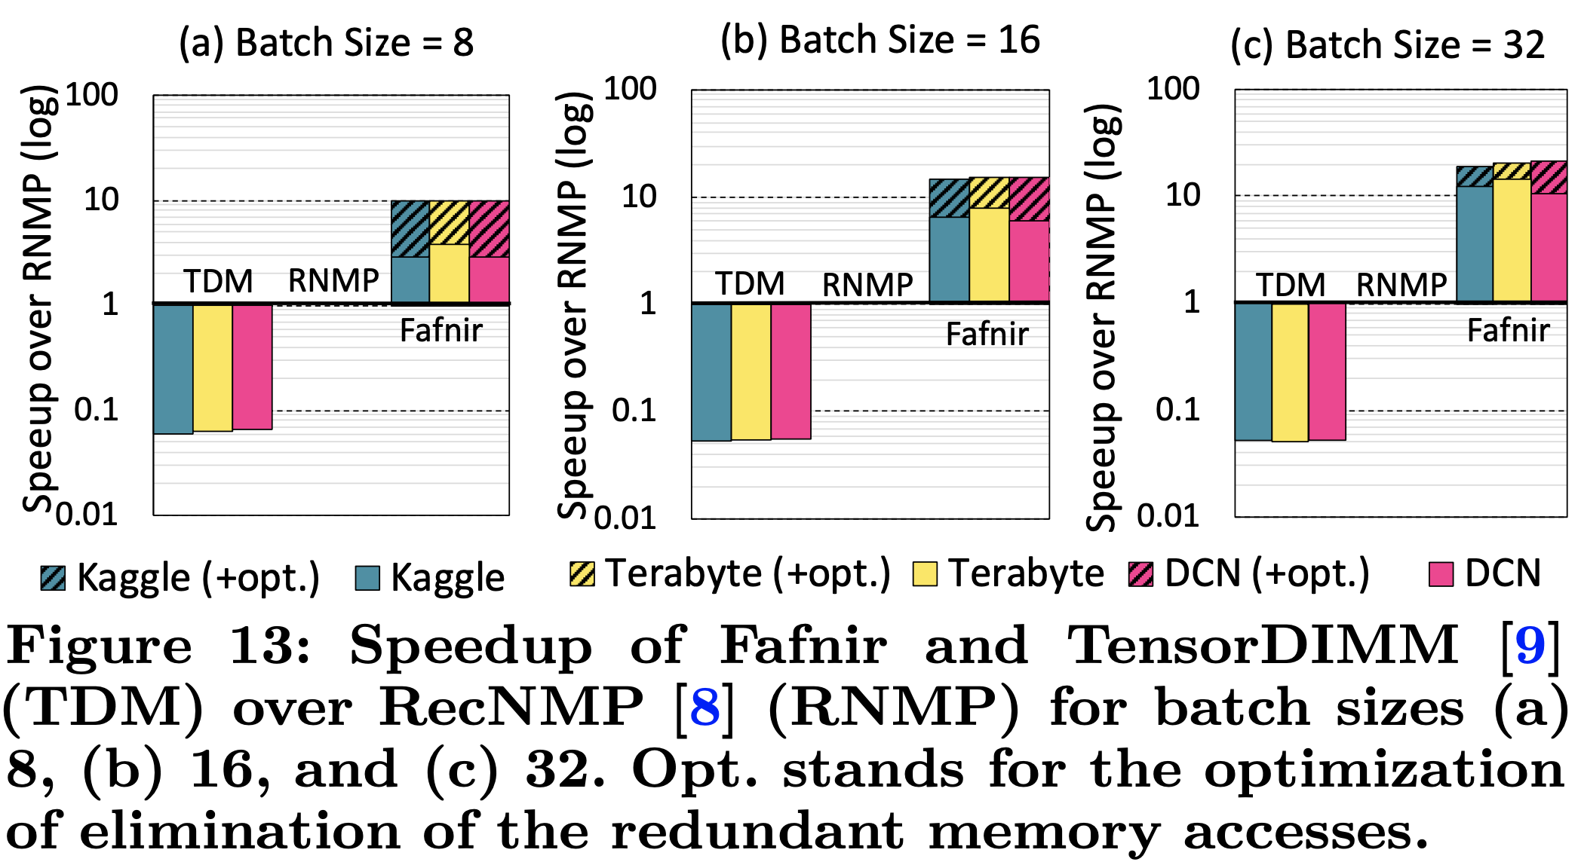
FAFNIR
Evaluation
Scalability according to batch size & # of ranks
(a): RecNMP, (b): Fafnir

Slide 24
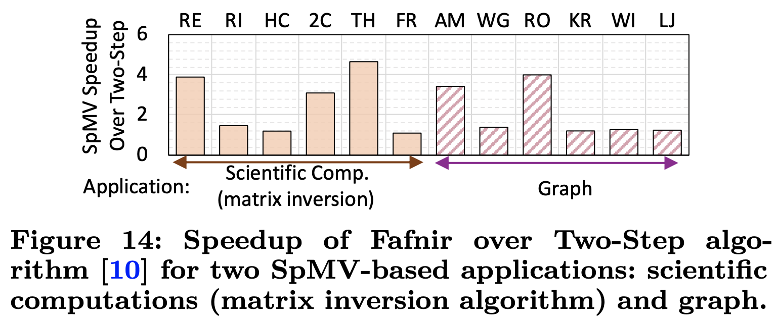
FAFNIR
Evaluation
SpMV: Speedup over baseline (Two-Step algorithm)

Slide 25
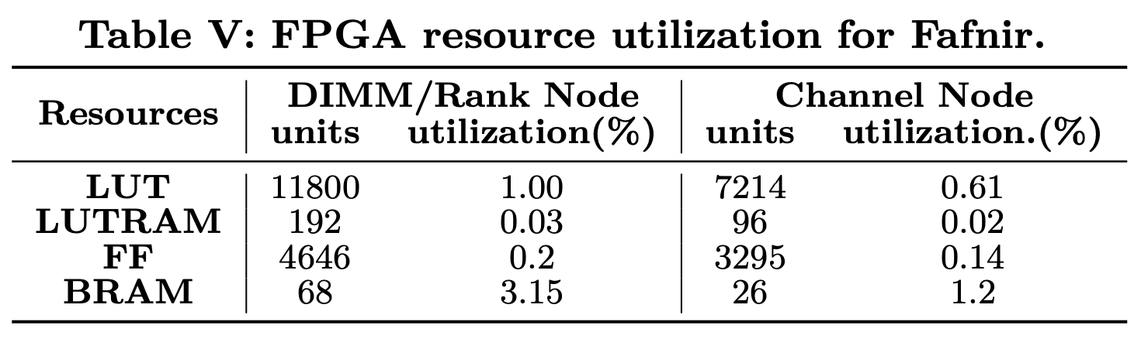
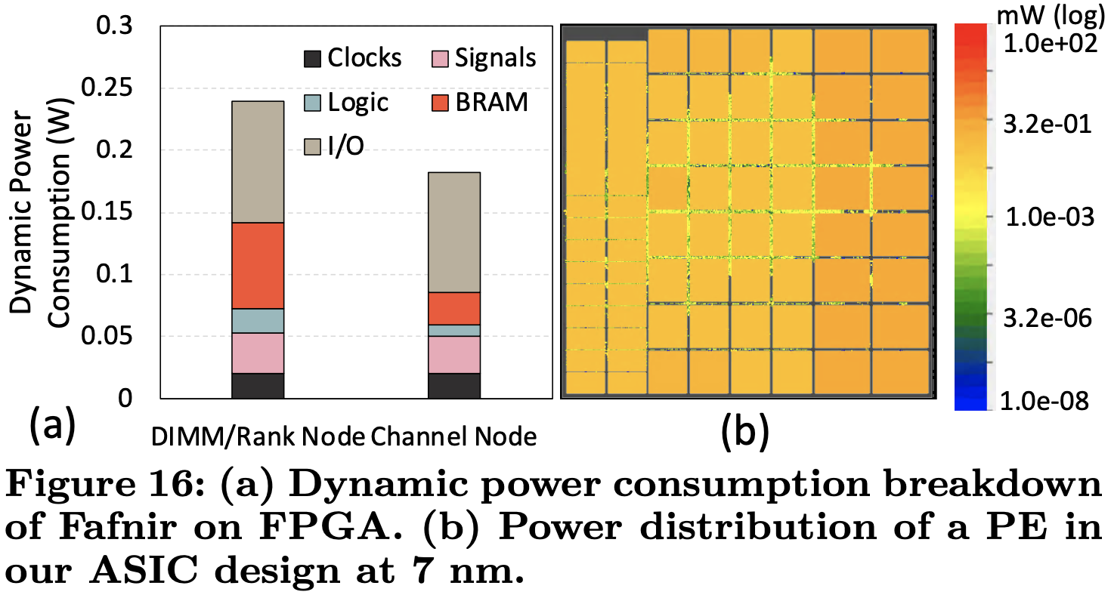
FAFNIR
Evaluation
Resource utilization & Power consumption
FPGA utilization: LUT – ~5%, LUTRAM – ~0.15%, FF – ~1%, BRAM – ~13%
Power consumption (FPGA)
Fafnir: DIMM/rank nodes - 0.23mW, channel node – 0.18W (in total, FPGA)
Uniform distribution, no hot spot (ASIC)

Slide 26
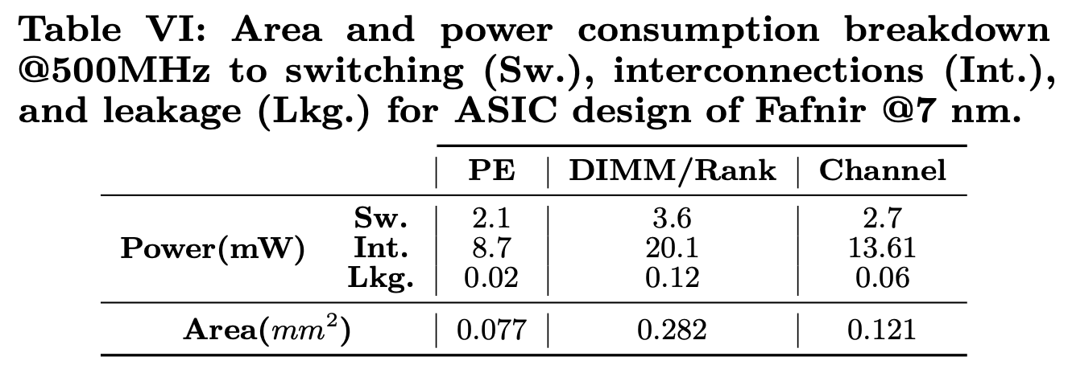
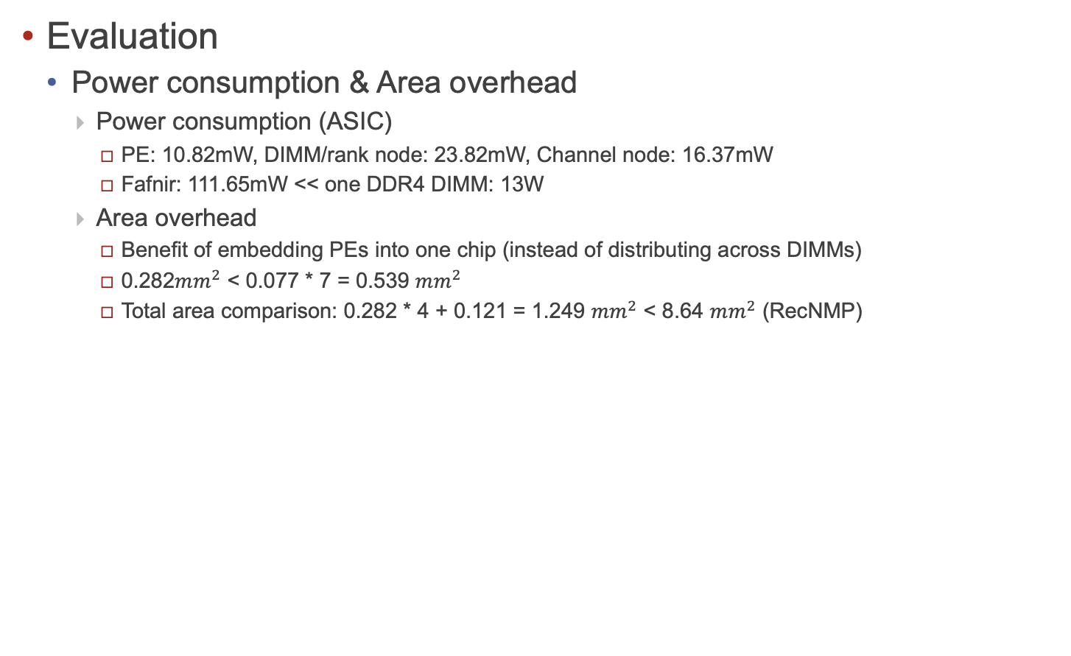
FAFNIR
Evaluation
Power consumption & Area overhead
Power consumption (ASIC)
PE: 10.82mW, DIMM/rank node: 23.82mW, Channel node: 16.37mW
Fafnir: 111.65mW << one DDR4 DIMM: 13W
Area overhead
Benefit of embedding PEs into one chip (instead of distributing across DIMMs)
0.282$mm^{2}$ < 0.077 * 7 = 0.539 $mm^{2}$
Total area comparison: 0.282 * 4 + 0.121 = 1.249 $mm^{2}$ < 8.64 $mm^{2}$ (RecNMP)

Slide 27
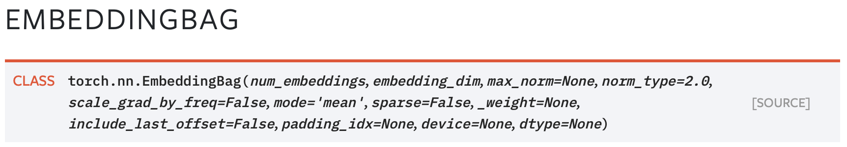
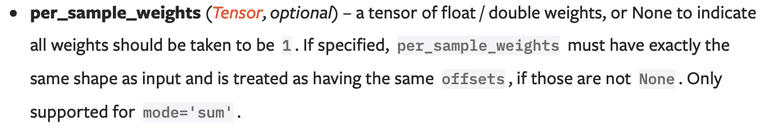
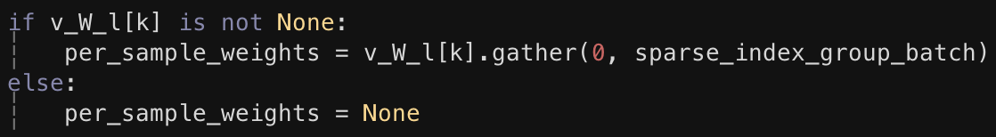
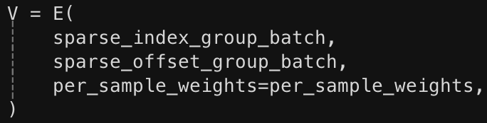
FAFNIR
Questions
How to apply Fafnir to weighted embedding lookup?
Even if the embedding vector is shared by queries, the weight of the vector would be different
PyTorch: nn.EmbeddingBag – compute sum (or other operations) of ‘bags’ of embeddings with no intermediate embeddings (abstraction)
Code from DLRM: nn.EmbeddingBag instantiation

Slide 28
Conclusion
Recommendation system is a hot topic in system/ML groups
Embedding lookup is the main bottleneck which is memory- intensive operation compared to DNN/RNN which are compute-intensive
FAFNIR is the one of architectural solutions which utilizes a reduction tree
Unique memory access
Scalable memory interconnection
Genericity

